Slide 1
Computer Organization and Assembly Language
CMP (Compare instructions)

Slide 2
The JMP instruction causes an unconditional transfer to a destination, identified by a code label
The syntax is
JMP destination
A conditional jump instruction branches to a label when specific register or flag conditions are met.

Slide 3
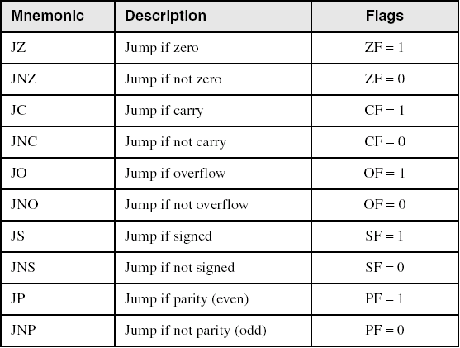
Jumps Based on Specific Flags (Single-Flag Jumps)

Slide 4
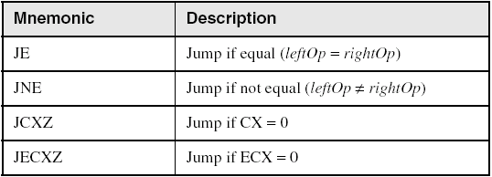
Jumps Based on Equality (Single-Flag Jumps)

Slide 5
Often, we need to branch when some value is larger (or smaller) than an other.
CMP eax, ebx
;now jump somewhere when eax > ebx
; ja will use if eax>ebx is “unsigned number”.
;jg will use if eax>ebx is “signed number”.

Slide 6
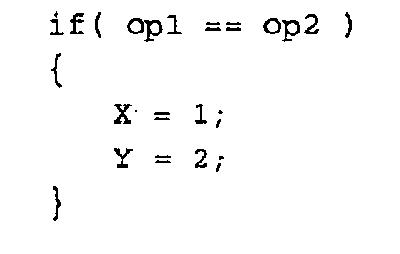

Slide 7
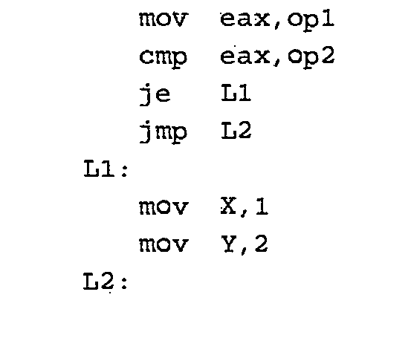

Slide 8
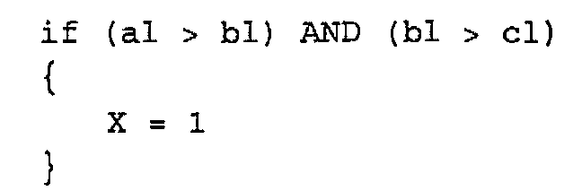

Slide 9
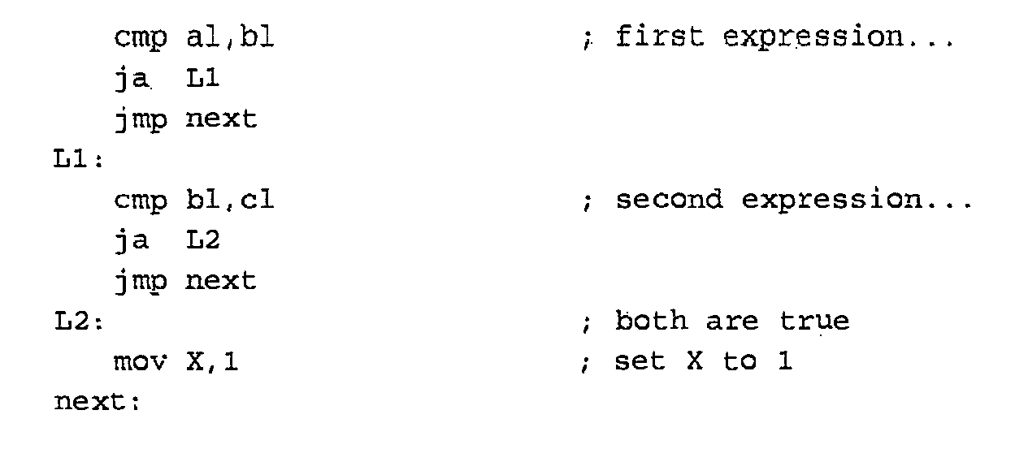

Slide 10
IF - else
.
if( var1 <= var2 )
var3 = 10;
else
{
var3 = 6;
var4 = 7;
}
{
mov eax,var1
cmp eax,var2
jle L1
mov var3,6
mov var4,7
jmp L2
L1: mov var3,10
L2:
(There are multiple correct solutions to this problem.)

Slide 11
Compound Expression with OR
if (al > bl) OR (bl > cl)
X = 1;
In Assembly:
cmp al,bl ; is AL > BL?
ja L1 ; yes
cmp bl,cl ; no: is BL > CL?
jbe next ; jump if below or equal
L1: mov X,1 ; set X to 1
next:

Slide 12
Unconditional Jump
INCLUDE Irvine32.inc
.data
msg BYTE ”hello”,0
.code
main PROC
mov edx,12345678h
jmp over
mov edx,OFFSET msg
over:
CALL WriteString
exit
main ENDP
end main
Instruction “mov edx,OFFSET msg” has not been executed

Slide 13
Character Print
INCLUDE Irvine32.inc
.code
main PROC
continue:
CALL ReadChar ;char in AL
cmp al,0 ;extended key?
je stop ;yes, then exit
CALL WriteChar ;no, print char
jmp continue
stop:
exit
main ENDP
END main

Slide 14
Conditional and unconditional Jump
include irvine32.inc
.data
Str1 byte “eax has greater number”,0
Str2 byte “ebx has greater number”,0
.code
main Proc
mov eax, 1
mov ebx, 10
cmp eax,ebx
jl Label 1
mov edx, offset str1
call writestring
jmp Label 2
Label 1:
mov edx, offset str2
call writestring
Label 2:
exit
main endP

